Slide 1
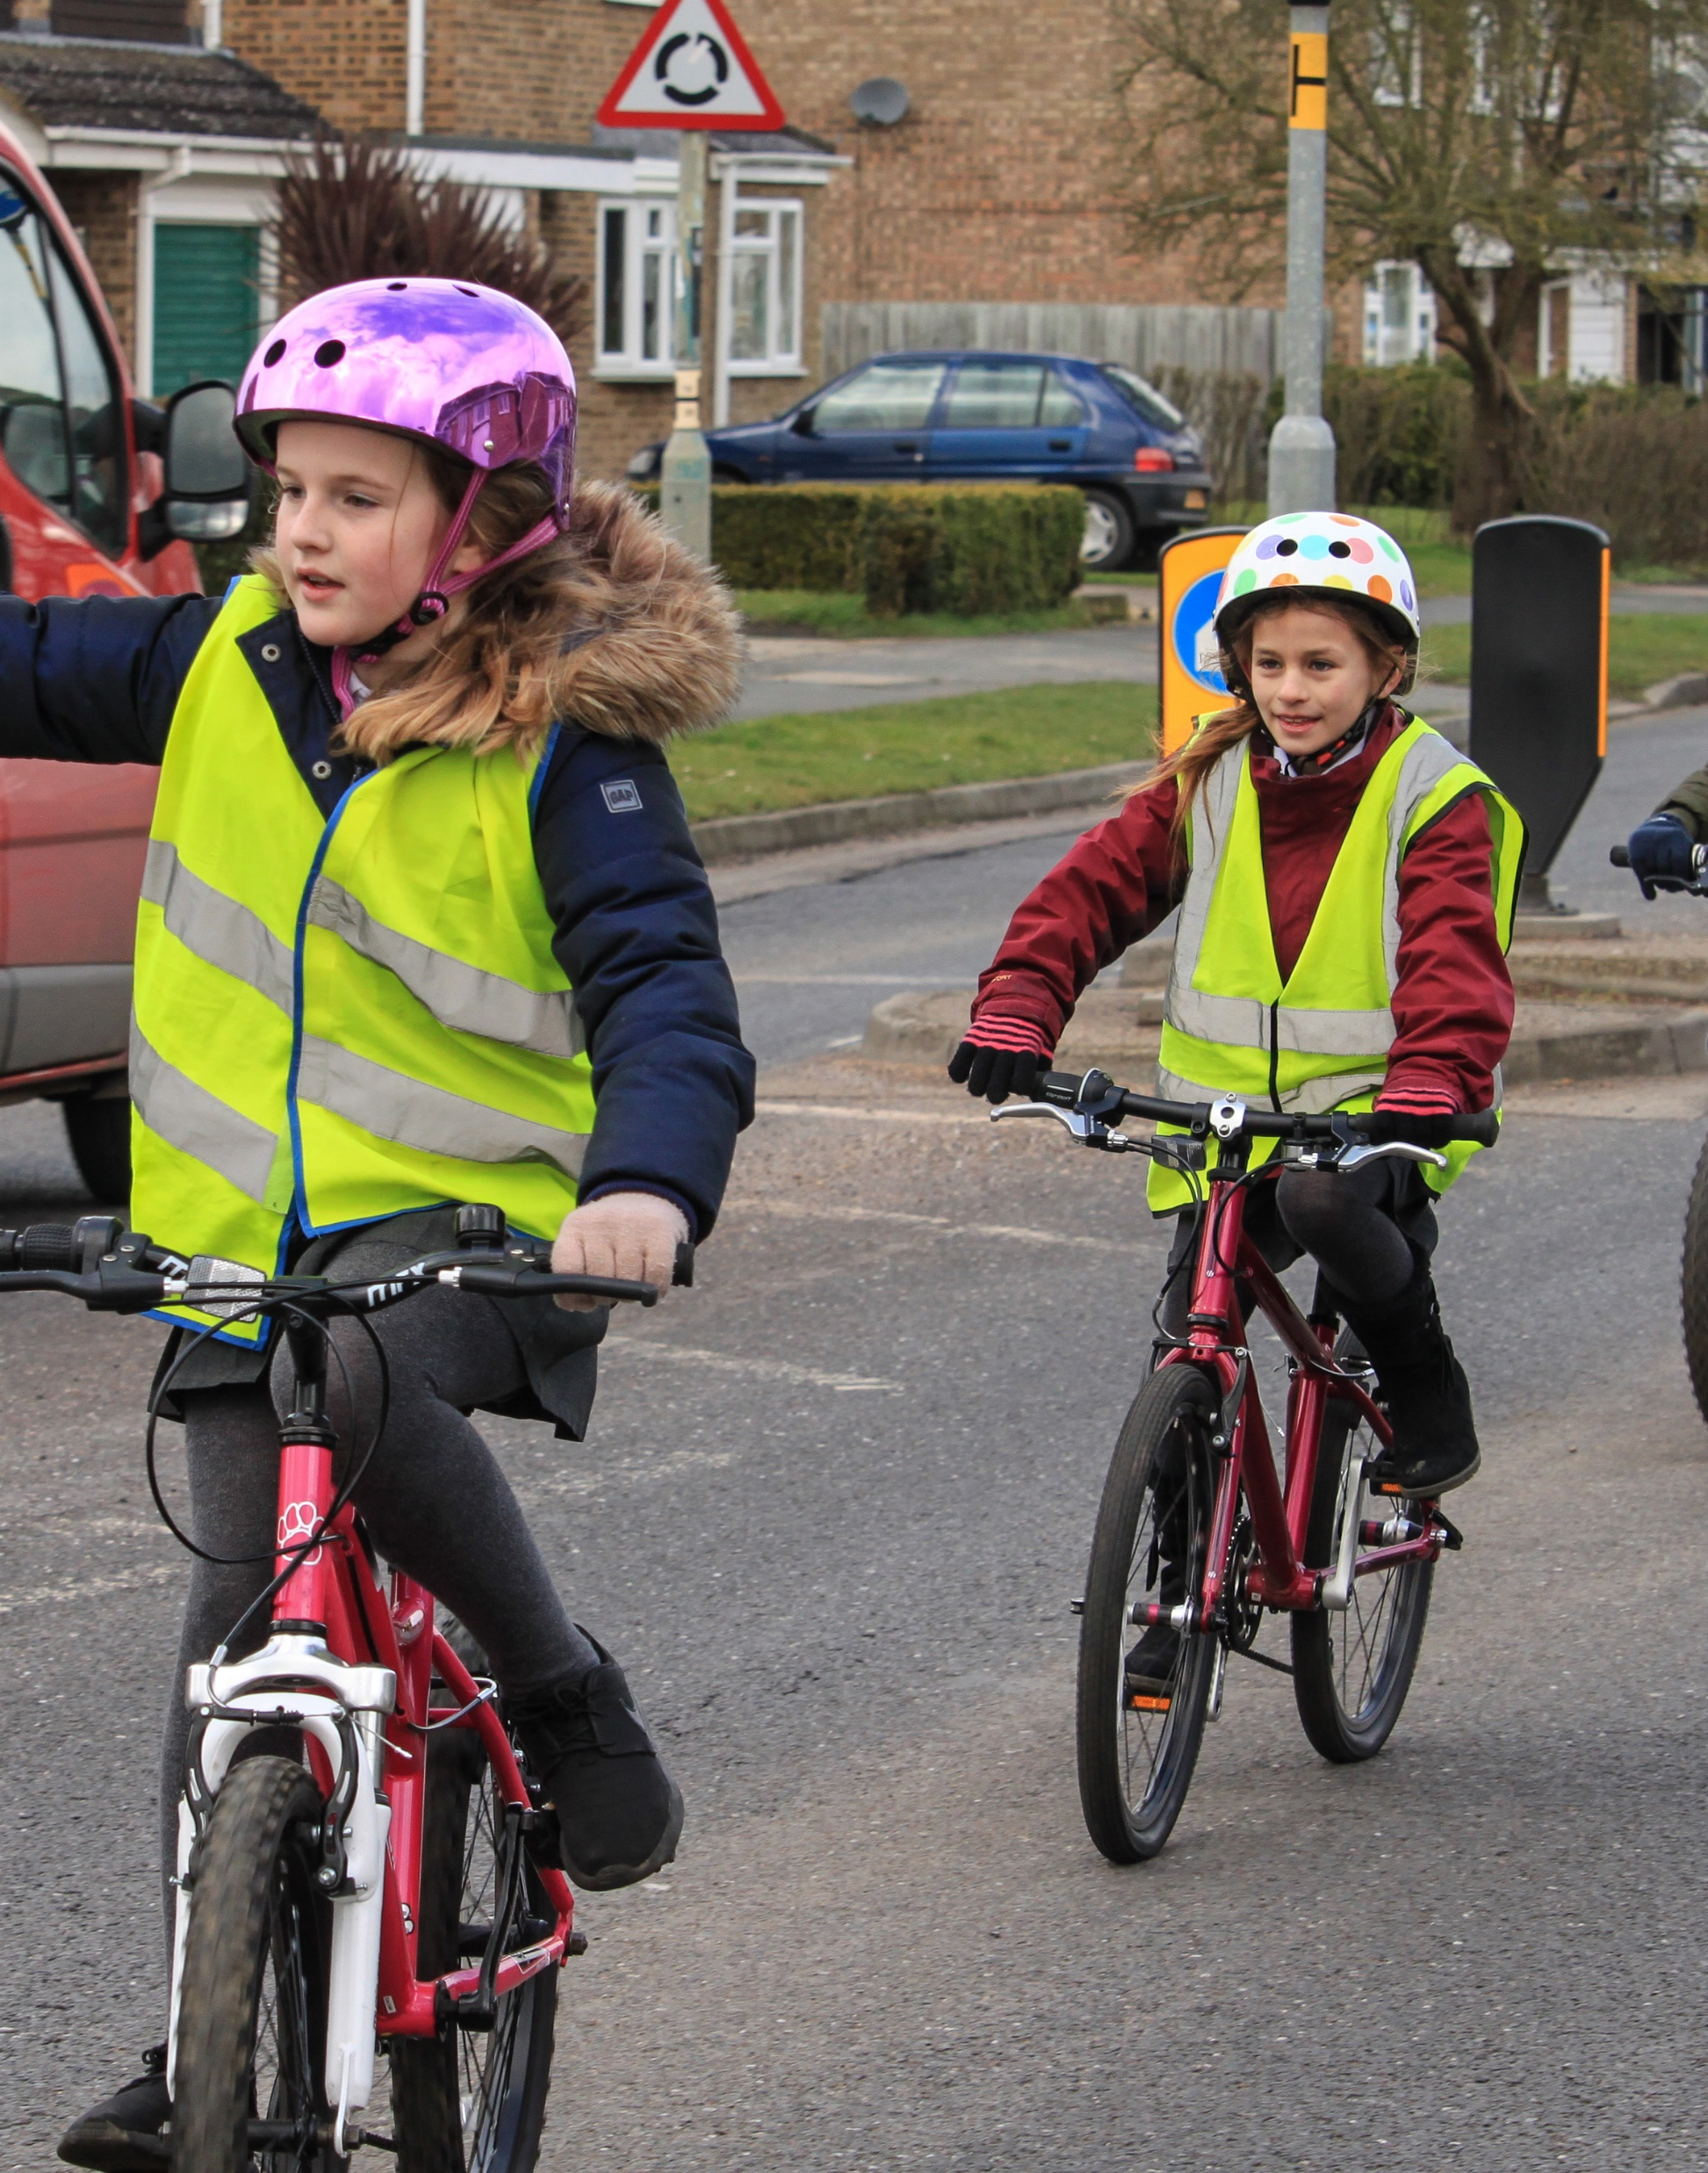


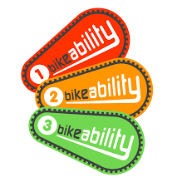


What is Bikeability?

Slide 2
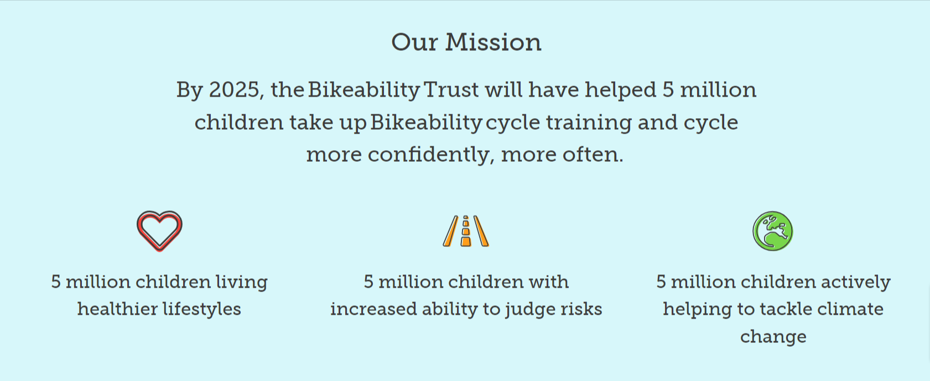
What is Bikeability?
Bikeability is a national cycle training programme designed to help you gain the skills, knowledge and understanding to cycle confidently on the roads.

Slide 3
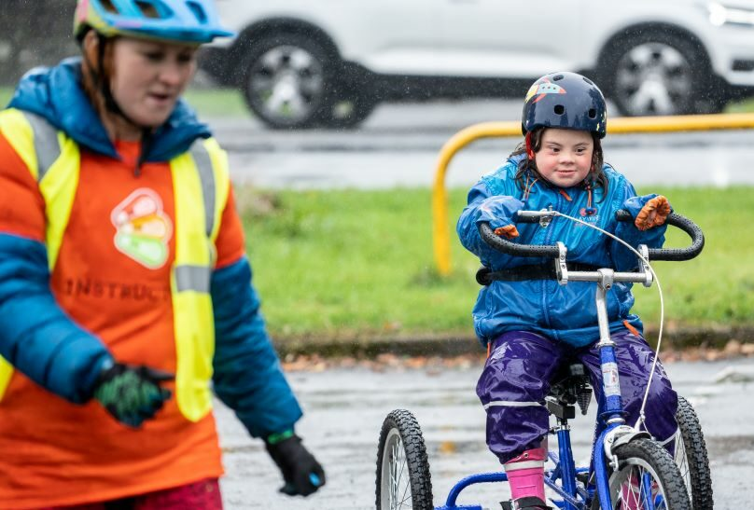
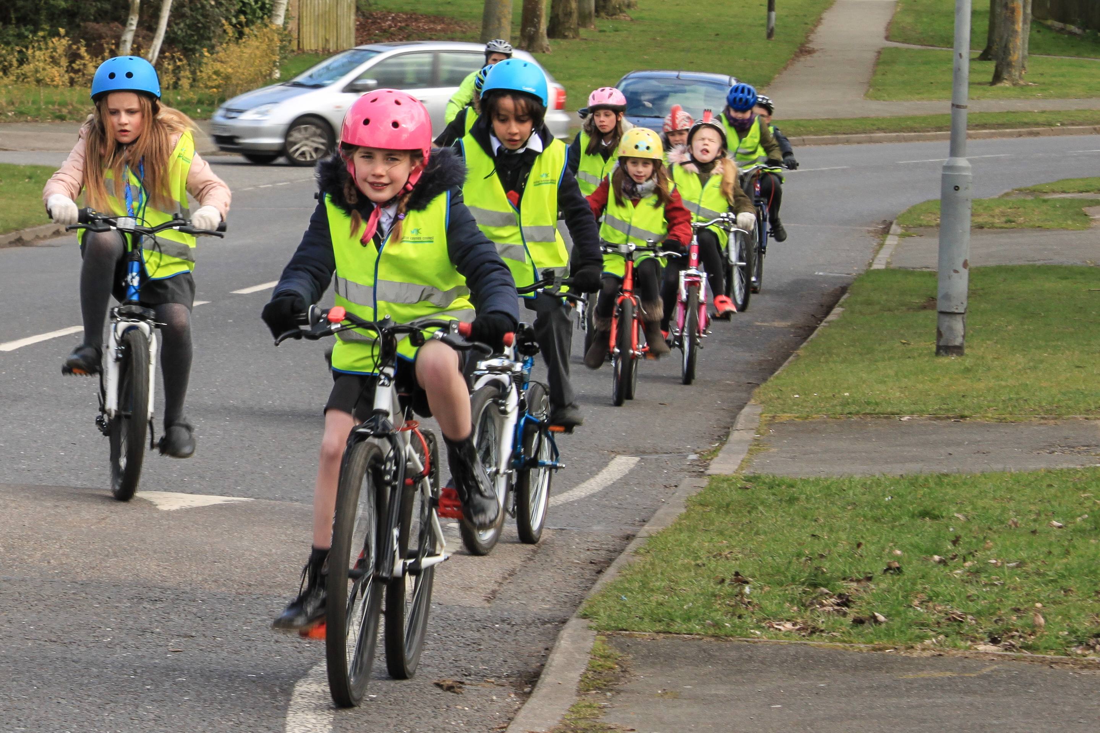
What are the benefits?

Slide 4










What are the benefits?
PHYSICAL
MENTAL
Good for your heart and lungs
Develops your muscles
Helps with balancing skills and awareness of your surroundings
Improves decision-making
Helps with planning and organisation
Increases independence
Gives you confidence and competence
SOCIAL
ENVIRONMENTAL
Spend time with your friends
Explore new places
Reduce pollution
Lower carbon footprint
Tackle climate change

Slide 5
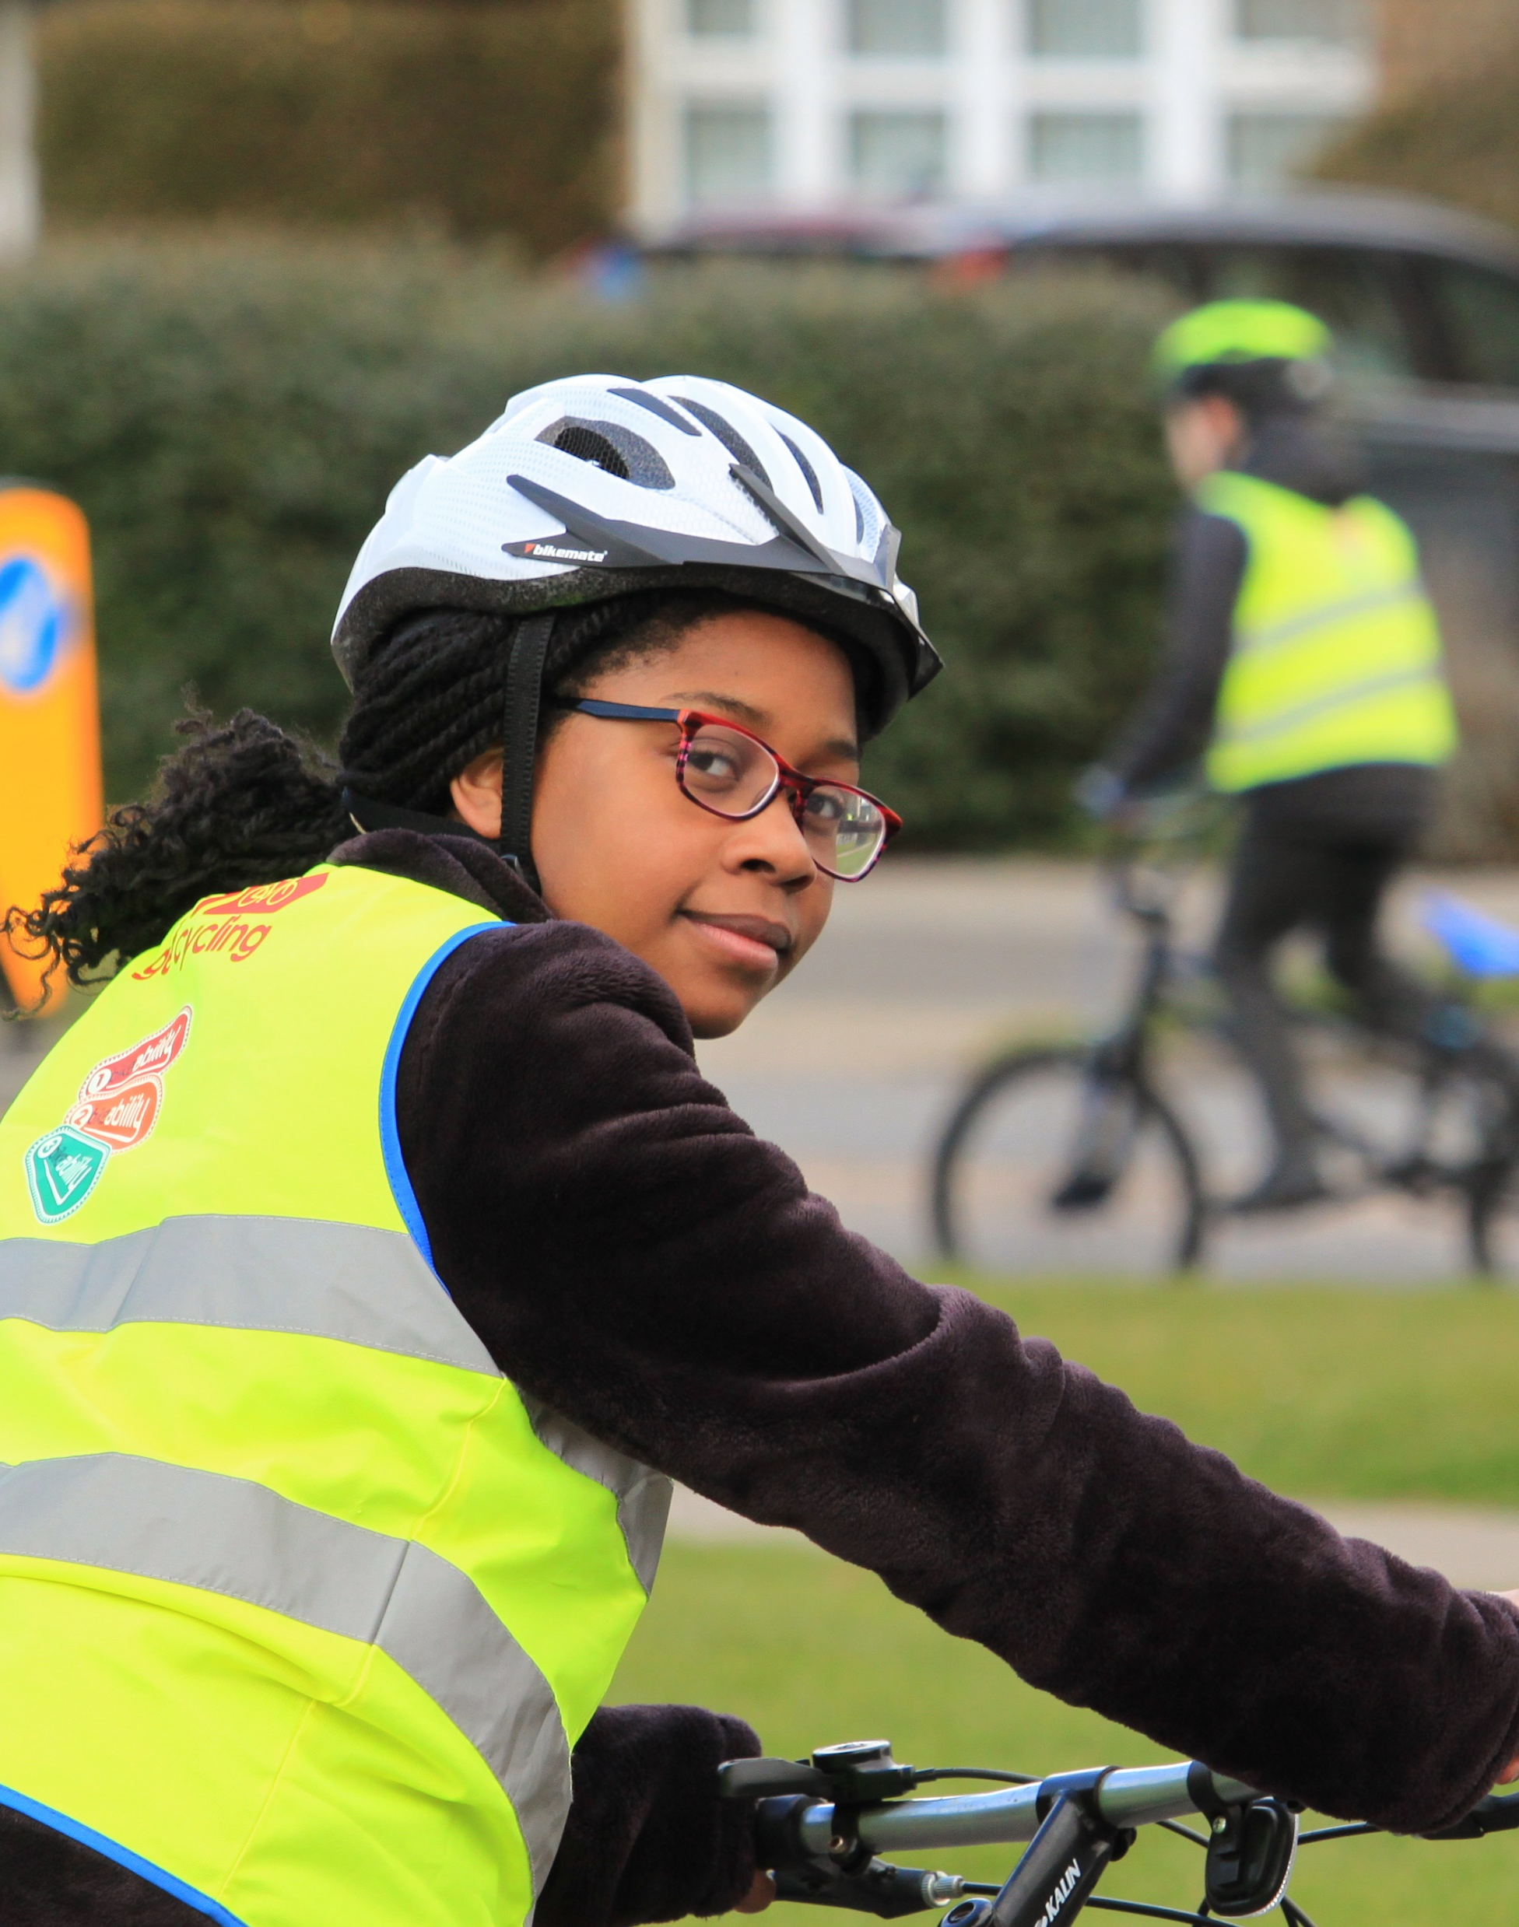
How does it work?

Slide 6
How does it work?
Level 1
Taught in a playground
Prepare you for a journey
Help you to check your bicycle is ready for the journey
Help you to set off, pedal, slow down and stop
Level 2
Taught on quiet, local roads
Help you to cycle safely and responsibly
Help you identify and respond to hazards
Help you to start and stop on-road journeys and maintain suitable riding positions
Show you how to share the road and communicate with other road users
Help you to understand the rules of the road
Communication
Observation
Position
Priority

Slide 7
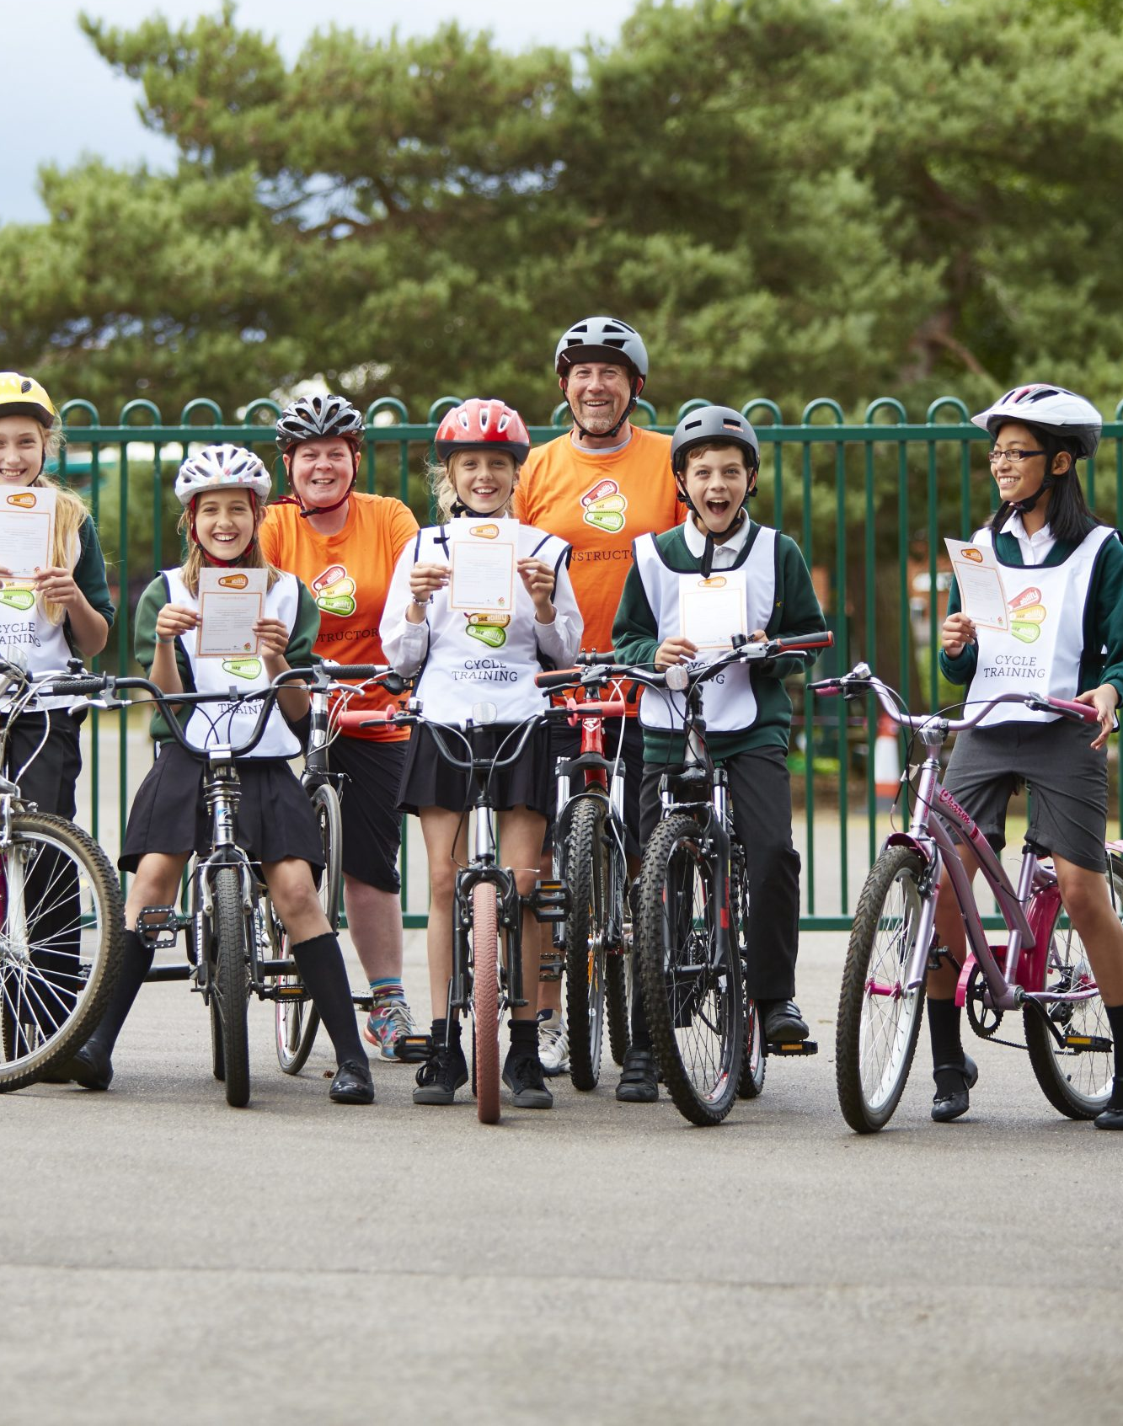

After you’ve completed the course, you’ll be presented with a Bikeability Level 2 Certificate and Badge!

Slide 8
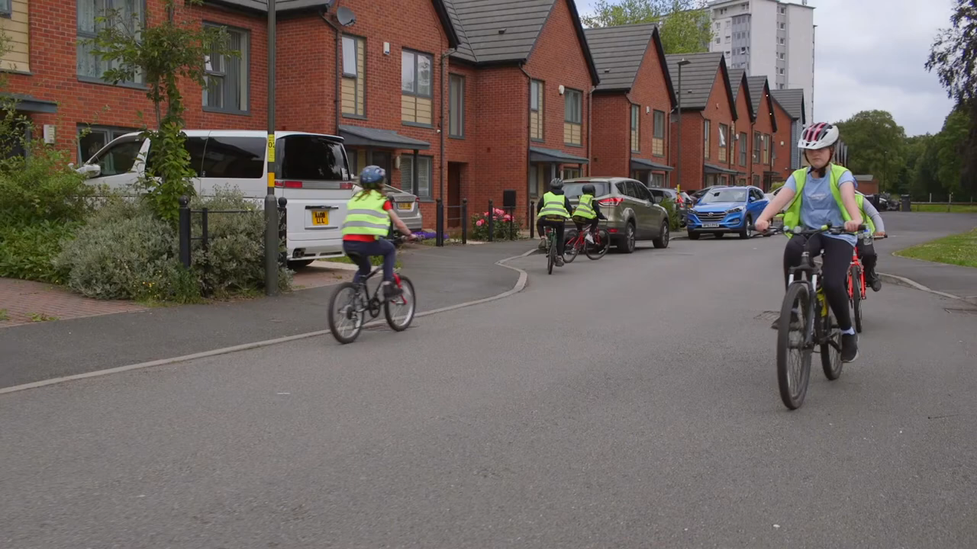
Notes:
A video of Bikeability in action and some comments from the riders.

